Slide 1
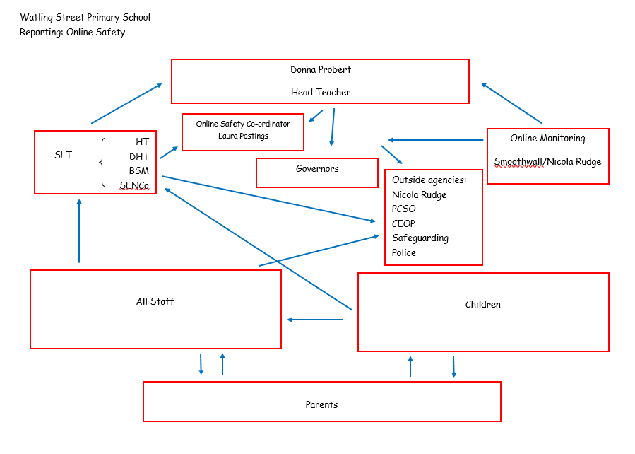
Lakeside Primary School
Reporting Online Safety
Neil Probert
Headteacher
SLT
HT
DHT
SENCo
SFSW
Online Safety Lead
Toby Swift
Online Monitoring
SENSO
Governors
Outside Agencies:
PCSO
CEOP
Safeguarding
Police
All Staff
Children
Parents

